Slide 1
Year 4
Multiplication Tables Check
Information Meeting - 30th September 2024

Slide 2
What is the Multiplication Tables Check?
It’s for Year 4s across the whole country.
It will be completed online this June – we have 3 weeks for all our children to complete it.
The children only get one ‘real’ go – they can’t resit it.
There is no pass mark.
Children sit it online.

Slide 3
What is the Multiplication Tables Check?
There are 25 questions.
All the questions are multiplication.
Questions are on every times table from 2s to 12s.
Will not be the same questions for each child.
3 practice questions before the 25 questions.
6 seconds to answer.

Slide 4
How is school preparing the children?
Lots of teaching of times tables.
Use what you know to solve what you don’t know.
Times Table Rock Stars.
Chances to practice so we know how it works – we know what to do if we can’t answer one.

Slide 5
This is what it feels like!
Please click on the link to have a go. There are lots of similar ones freely available on the internet. This one is by Maths Frame.
Multiplication-Tables-Check

Slide 6
How can I help my child/children?
Ideas away from screens – in the car is a perfect time!
Practice makes permanent - not just perfect.
Use our helpful home sheet for some ideas.
TTRS – little and often. 10 minutes per day is better than an hour a week.
LET IT GO! Don’t get bogged down in a tricky one.
Don’t let older siblings help – this distorts the questions set and leads to more upset than anything else we have with TTRS.

Slide 7
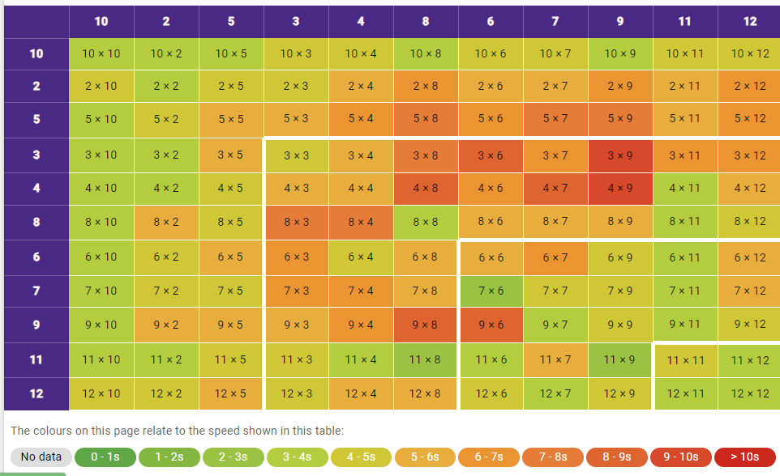
Knowing what to practice
Click Rockstar name on top right and choose
My Stats.
Effort – how often your child is practising?
Fluency – heat map – see which tables need more work.

Slide 8
How does TTRS work?
Click on the link for a Youtube guide to the
A guide to TTRS games

Slide 9
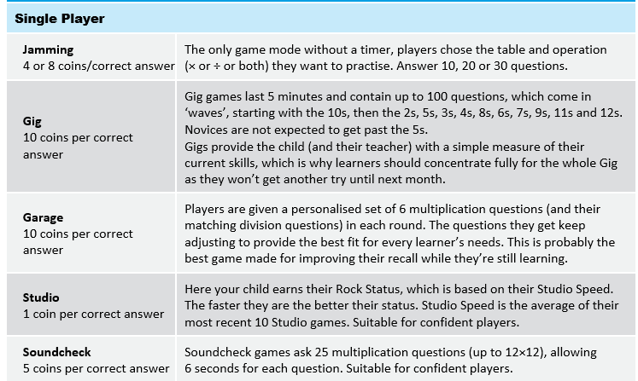

Slide 10
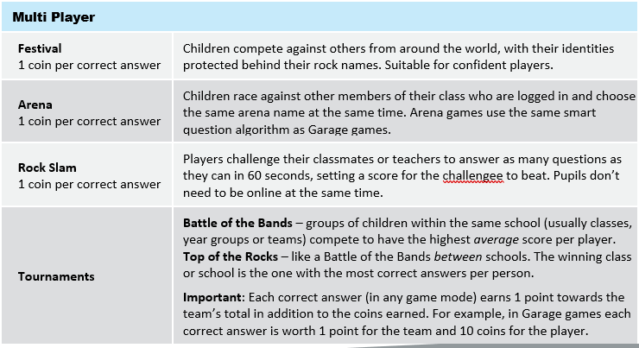

Slide 11
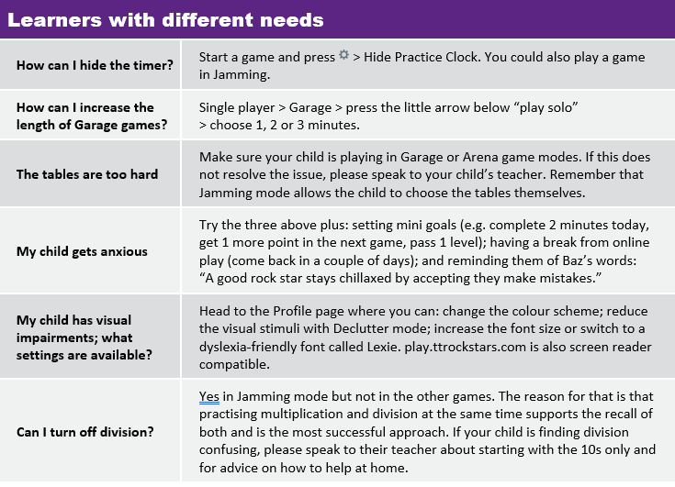

Slide 12
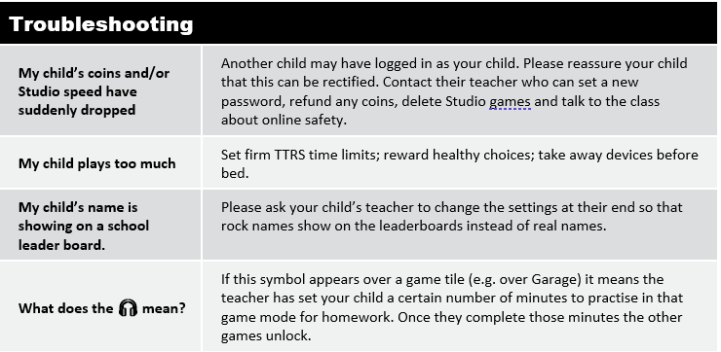

Slide 13
Any Questions?
If you have any questions, please do not hesitate to contact the school.
All support materials are saved on the school website. In the Year 4 section and the maths section.
Many thanks for your continued support.
Year 4 Team

